Slide 1
Renyi’s comments, 03/27/21
Cranberry diet was not included in the Results section, but it's in the title and included in the figures. Need to include or exclude cranberry for all parts.
The figure labelling is not consistent. timepoint Week_4 in Fig 1 but week_8 in Fig. 4. and labels such Con_PEI_18, con_PEI_19 , are confusing ( I know 18 and 19 refer to the year the experiments were performed, but not relevant here)
The circle figures (Fig 5-7) are hard to understand for average readers.
The 16s sequencing data, raw and analyzed, may need to be uploaded to NCBI GEO.

Slide 2

Experiment 1:
Group1: Nrf2-/-, AIN93M (N=3)
Group2: Nrf2-/-, PEITC (N=3)
Experiment 2:
Group3: WT, AIN93M (N=5)
Group4: WT, PEITC (N=5)
Experiment 3:
Group5: WT, AIN93M (N=3)
Group6: WT, AIN93M, DSS (N=3)
Group7: WT, Cranberry, DSS (N=3)
Group8: WT, PEITC, DSS (N=3)
Group9: Nrf2-/-, AIN93M (N=3)
Group10: Nrf2-/-, AIN93M, DSS (N=3)
Group11: Nrf2-/-, Cranberry, DSS (N=3)
Group12: Nrf2-/-, PEITC, DSS (N=3)
AIN93M : Groups 1, 3, 5, 6, 9 and 10
AIN93M: Groups 2, 4,
7, 8, 11 and 12
AIN93M + 0.05% PEITC Groups 2, 4,8 and 12
AIN93M + Cranberry: Groups 7 and 11
X
X
X
X
X
Week 0 1 2 4 6 8
Gut microbiota equalization period (2 weeks)
Notes:
Figure 1: experimental design. Mice fecal samples for the 16S sequencing were collected individually at 3 timepoints – at the end of the 2-week equalization period (Week 0), at an early timepoint (Week 1) and at a late timepoint (Week 4 or Week 8). Samples used for metabolite analysis were collected at an early and a late timepoints (Weeks 2 and Week 6 respectively).

Slide 3
Figure 2: 16S sequencing depth

Slide 4
Table 1: OTUs mapping to Kingdoms. Number of OUT (% total)
Kingdom | Experiment 1: Nrf2 KO Mice | Experiment 2: WT Mice | Experiment 3: WT and Nrf2 KO
Bacteria | 10,197 (94.78%) | 7,994 (98.34%) | 7,558 (96.07%)
Eukaryota | 472 (4.39%) | 116 (1.43%) | 232 (2.95%)
Unknown | 86 (0.80%) | 19 (0.23%) | 75 (0.95%)
Archaea | 4 (0.04%) | 0 (0%) | 2 (0.03%)

Slide 5
Figure 3: Shannon’s index (Alpha Diversity)

Slide 6
Figure4: Bacteroidetes vs. Firmicutes. Experiments 1 and 2 (left), and 3 (right).

Slide 7
Bacteroidetes/Firmicutes Analysis
Wile Type
Nrf2 KO
Term | Estimate | 95% C.I.L.L. | 95% C.I.U.L. | p-Value | Sign
Week 0 | 1.634 | 1.31 | 2.039 | <0.001 | **
Week 1 | 0.969 | 0.777 | 1.209 | 0.774
Week 4 | 1.009 | 0.809 | 1.259 | 0.933
PEITC/AIN93M | 0.998 | 0.73 | 1.365 | 0.992
Week 1:PEITC/Week0:AIN93M | 0.989 | 0.635 | 1.54 | 0.96
Week 4:PEITC/Week0:AIN93M | 1.089 | 0.7 | 1.696 | 0.694
Term | Estimate | 95% C.I.L.L. | 95% C.I.U.L. | p-Value | Sign
Week 0 | 2.097 | 1.467 | 2.995 | <0.001 | **
Week 1 | 1.891 | 1.539 | 2.324 | <0.001 | **
Week 4 | 1.393 | 1.134 | 1.712 | 0.002 | **
PEITC /AIN93M | 1.036 | 0.774 | 1.386 | 0.809
Week 1:DietPEITC/Week0:AIN93M | 0.757 | 0.501 | 1.143 | 0.179
Means and SEM of Bacteroidetes/Firmicutes Ratios
Genotype | Diet | Week 0 | Week 1 | Week 4
Wild Type | AIN93M | 1.66(0.15) | 0.97(0.04) | 1.04(0.12)
Wild Type | PEITC | 1.72(0.26) | 0.98(0.1) | 1.11(0.09)
Nrf2 KO | AIN93M |  | 2.02(0.27) | 1.43(0.12)
Nrf2 KO | PEITC |  | 1.52(0.11) | 1.51(0.15)
Nrf2 KO | Pooled | 2.15(0.35)

Slide 8
Figure4: PCA at Phylum level. Experiments 1 and 2 (left), and 3 (right).

Slide 9
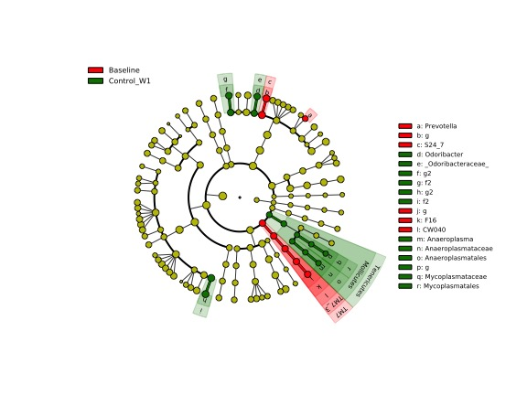
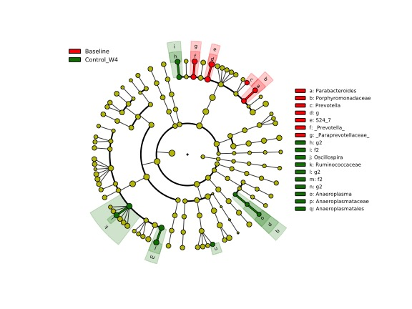
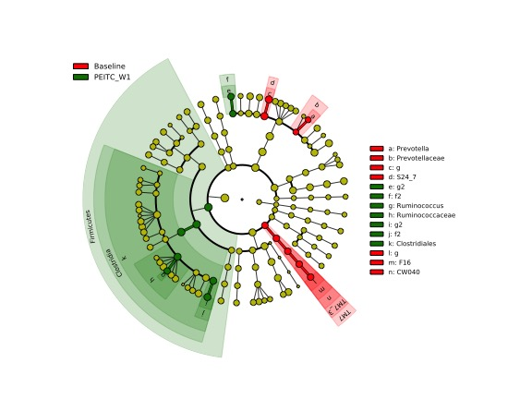
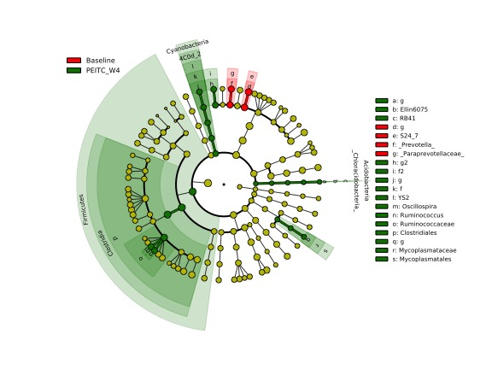
Figure 5:
A
B
C
D

Slide 10
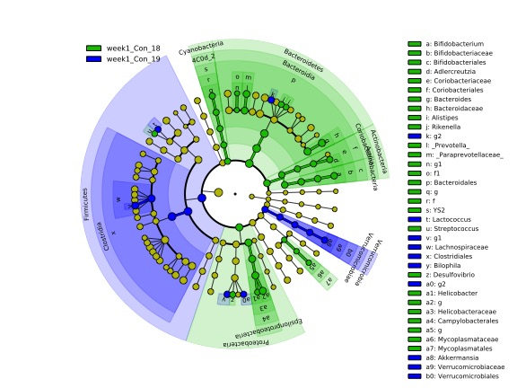
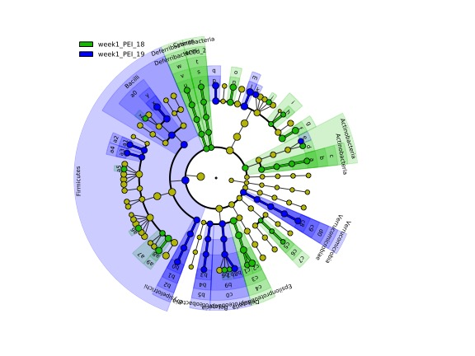
Figure 6
A
B

Slide 11
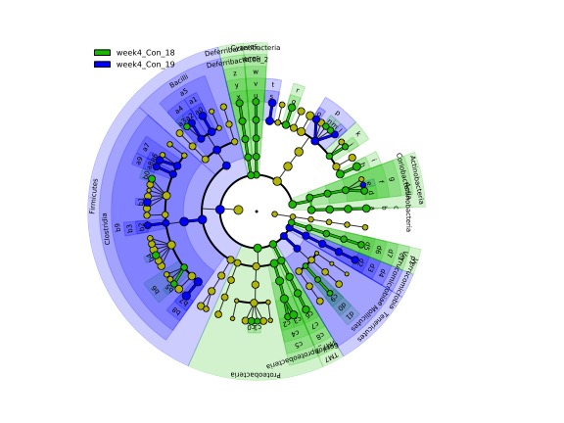
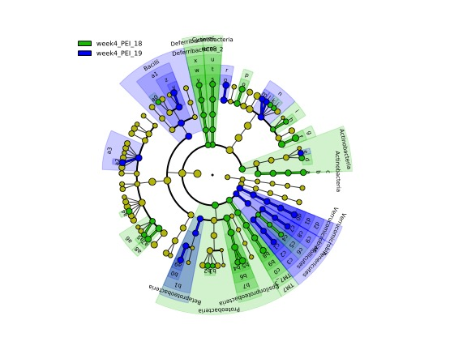
Figure 7
A
B

Slide 12
Figure 8: Aminoacids (Experiment 3 only)

Slide 13
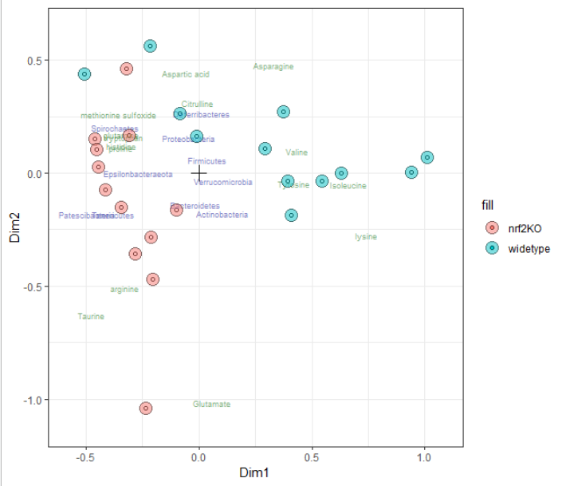
Figure 8: COMBI data integration – microbial counts + aminoacids

